Slide 1
Excellence in Research @ Royal Holloway Prof Kathy Rastle Associate VP (Research)
Open Access and Research Data Event
October 2014
Notes:
Thank you to all of you for coming, to the excellent speakers that have travelled to Royal Holloway today, to Drs Nancy Pontika and Dace Rozenberga for organizing this event, and to the EU “Foster Open Science” project for paying for it. I am delighted to have been asked to open this event.

Slide 2
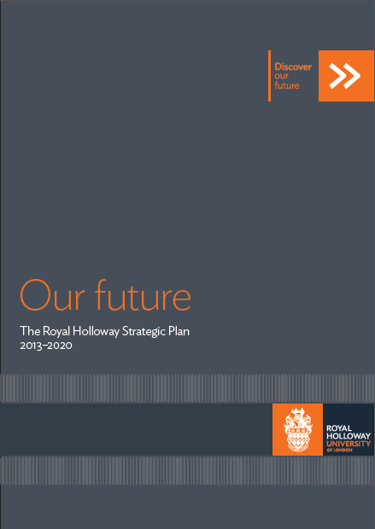
“Excellent research is a hallmark of all of the University’s activities”
Notes:
Last year, we launched an inspiring vision for the future of the institution.
It lays out four core themes and three supporting themes.
While ‘research’ is one of the core themes, what I like about this document is that it recognizes that excellence in research is actually at the heart of all of our activities and successes as an institution.
This plan put forward an ambitious vision for the institution to be recognized as one of the UK’s top 20 universities, and to hold our place as one of the world’s leading institutions.

Slide 3
Indicators of Excellence
18th in the UK
9 departments in the top 10
17th in the UK
118th in the world
International outlook (1st in the UK; 6th in the world)
Research influence (1st in the UK; 11th in the world)
Notes:
The indicators reveal that we are starting this journey in a good place.
The 2008 RAE placed us 18th in the UK on the proportion of 3* and 4* research, with 9 of our departments place in the top 10, including our world-leading Music department which placed first in the country.
Similarly, the recent Times Higher Education World University Rankings places us 17th in the UK and 118th in the world; and we lead the UK in both international outlook and in the influence of our research.
We are eager to hear the outcome of the 2014 REF exercise, where we were also, for the first time, able to describe the profound impacts of our research in communities locally, nationally, and internationally.

Slide 4
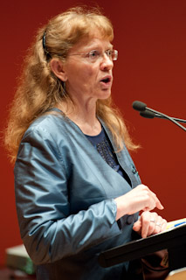
The Stories Behind the Metrics
Notes:
Behind these metrics are hundreds of success stories of individual academics, their research teams, and the professional services at Royal Holloway that support their work.
These include
the award of a Regius Professorship to our renowned Music department – the first ever awarded to a Music department;
major European funding to support our physics’ department’s search for dark matter and our Drama department’s work on indigenous performance;
the discovery of the gene underlying Duchenne’s muscular dystrophy which has contributed to a gene therapy solution now in clinical trials;
major funding from the Wellcome Trust for our Psychology department to conduct the first population study of language ability and risk for language impairment in school children in the UK;
research which has influenced Holocaust education and remembrance around the world;
And prize-winning poetry

Slide 5
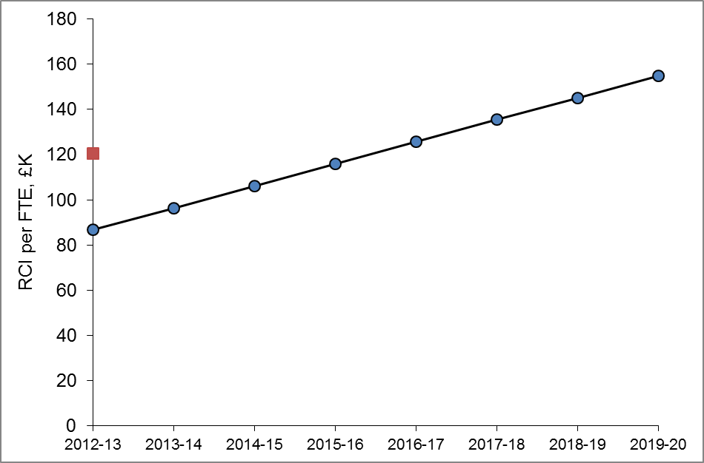
New Initiatives
20
Annual mini-REF (first iteration January, 2015)
More sophisticated benchmarking and target setting
Crystallise what a RHUL researcher looks like
Develop smart, effective support to achieve research aspirations
Enhance networks with industry, government agencies, cultural bodies
Notes:
We continue to push and challenge ourselves.
Recently, the Research Committee has produced a statement crystallising what a RHUL researcher aspires to; we are engaged in more sophisticated benchmarking of our work and target setting for the future; we are already engaged in planning for the REF exercise that we expect in 2020; we continue our work to enhance our networks with industry, government, and culture bodies; and we continue our work to develop smart, effective support mechanisms to achieve our research aspirations.
Finally, we continue and will continue to make the case that world-leading research is found in abundance in small research-intensive universities such as Royal Holloway.
All of these initiatives drive metrics, of course, but they push us and help us to be better, more effective researchers, which is what I think that academics are really interested in.

Slide 6
Open Access
Royal Holloway strongly supports Open Access
Royal Holloway strongly supports the HEFCE Open Access Policy
Notes:
This is an open access event, and it is international open access week, so I need to say something about Open Access.
RHUL strongly supports Open Access.
OA helps us to advance our mission in many ways.
It advances shared knowledge;
it increases the visibility of our research to the broad community of users;
it accelerates the pace of our work;
and it enhances the public good in multiple ways that are central to our mission.
In fact, Royal Holloway has had an open access policy and institutional repository in place since 2010, but uptake has been slower than we would like. Thus, we are strongly encouraged by the leadership that HEFCE has shown on this issue in providing a framework for us to start making the products of our research immediately openly accessible as a matter of routine. We further support key aspects of this policy – notably the use of institutional repositories for the immediate deposit of our work – and believe that it is a policy that we can successfully comply with.
With that, I would like to thank you for listening, and I am sure that you will join me in welcoming our speakers today.

